Slide 1
Capstone Project - Retail Analysis Presentation

Slide 2
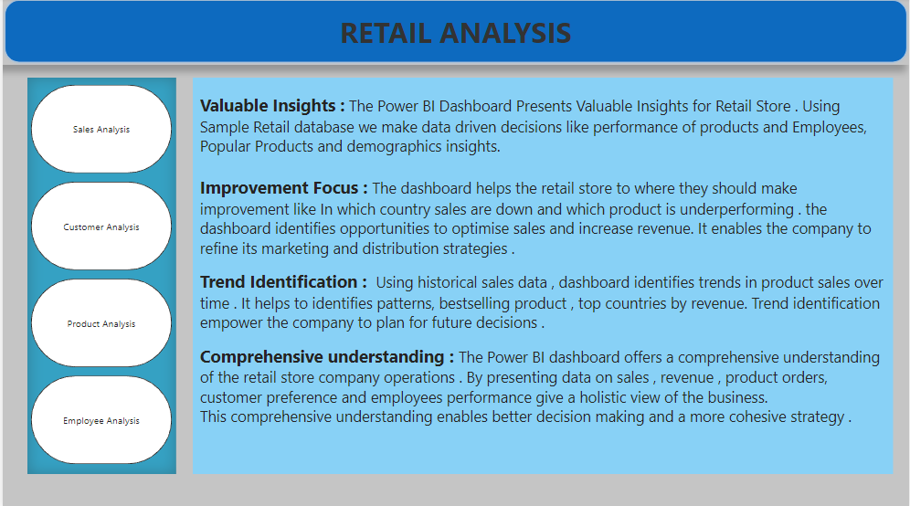

Slide 3
Objective: The objective of this project is to create a comprehensive Power BI dashboard utilizing the Sample Retail Database. The dashboard aims to provide valuable insights into the Retail company's sales performance ,product performance , customers insights , and product distribution, enabling data-driven decision-making and strategic planning.
Analysis Scope: The analysis will focus on various aspects of the retail company, including product sales, Employees performance, customer preference , demographics analysis , and the impact of discounts.
Goal: The primary goal of this Power BI dashboard is to offer a holistic view of the Retail company's operations. It will provide actionable insights to optimize product sales and customer preference , improve product marketing strategies, and identify opportunities for growth and efficiency.
Insights & recommendations: The Power BI dashboard will generate valuable insights into the top-selling product ,High value customers and sales trends over time. It will analyse the performance of products in different regions , it will recommend effective discount and marketing strategies to boost products sales and customer engagement.

Slide 4
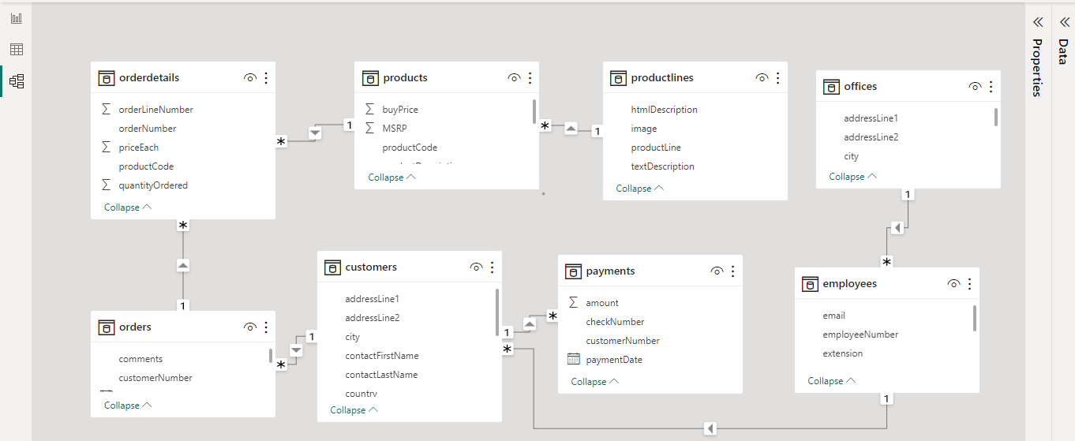
ER - DIAGRAM

Slide 5
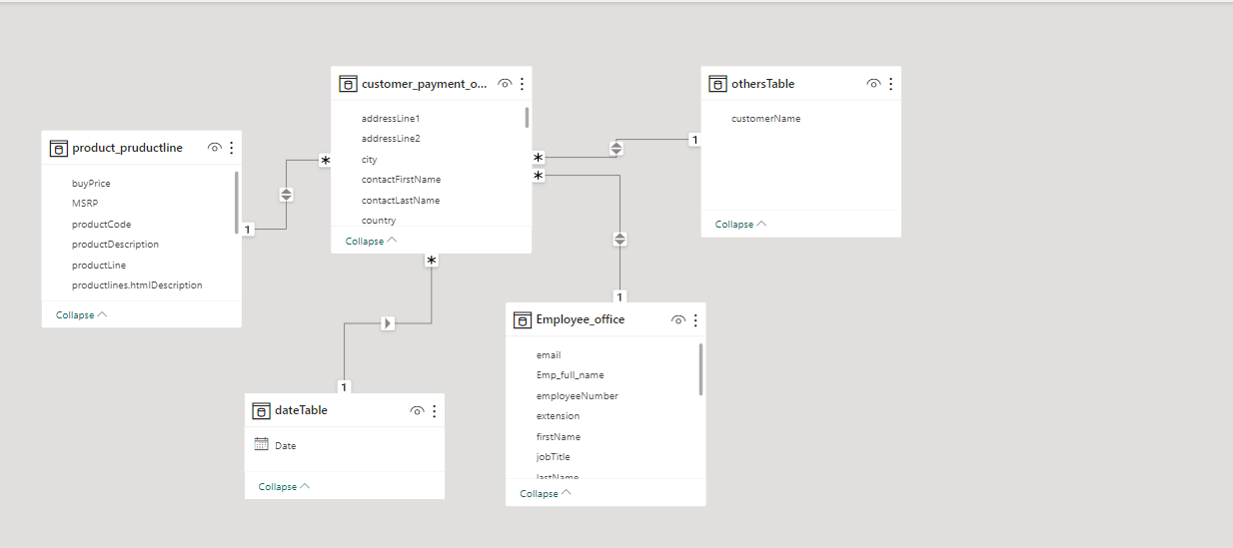

Slide 6
Power BI Problem Statements

Slide 7
Power BI Questions --
1. What are the top regions in terms of sales revenue ?
2. How does product pricing impact sales volume ?
3. How does monthly revenue vary across different product categories ?
4. What is the distribution of customers across different countries ?
5. What is the trend in customer order volume over the past year ?
6. How does the sales performance of top customers compare to the rest ?
7. What is the correlation between customer demographics and purchase frequency ?
8. What is the distribution of product sales across different product line ?
9. How does the performance of sales employees vary across different region ?

Slide 8
Following questions do not have Sufficient data --
1. How does customer lifetime value vary for different customer acquisition channels ?
2. What is the correlation between customer age and purchase frequency ?
Some more Questions that also give valuable insights --
1. What is the distribution of customers across different Product categories ?
2. What is the growth rate of product categories ?
3. What is the distribution of employees in various office cites ?

Slide 9
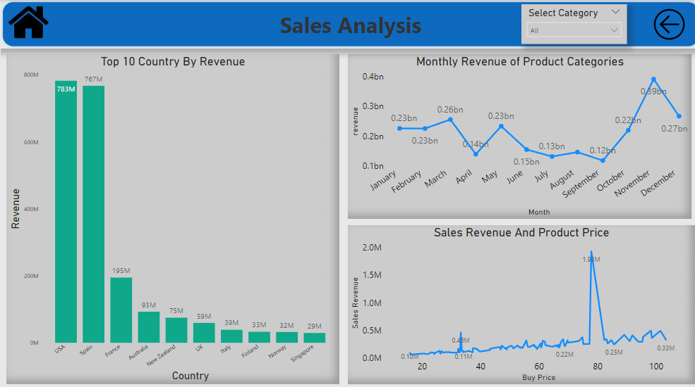

Slide 10
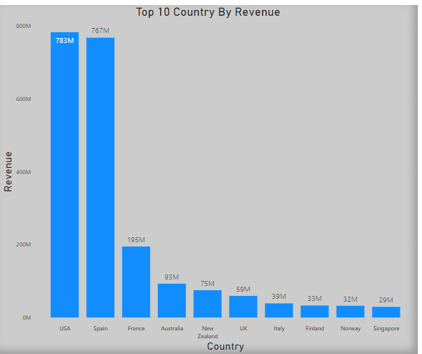
What are the top regions in terms of sales revenue ?
In terms of sales revenue USA and Spain generate highest revenue 783M and 767M . In visual we can see top 10 country by sales revenue.

Slide 11
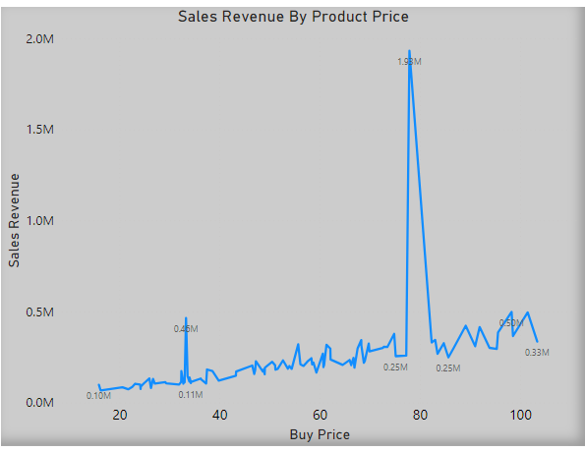
How does product pricing impact sales volume ?
Product price make a significant impact on sales revenue . In this visual we can see when product price in 10-50 then sales revenue is not much and when price is 85-100 then revenue is greater then 10-50 price range , but when product price in mid range like 60-85 then revenue is significantly high , it indicate that customer preference is mid range price.

Slide 12
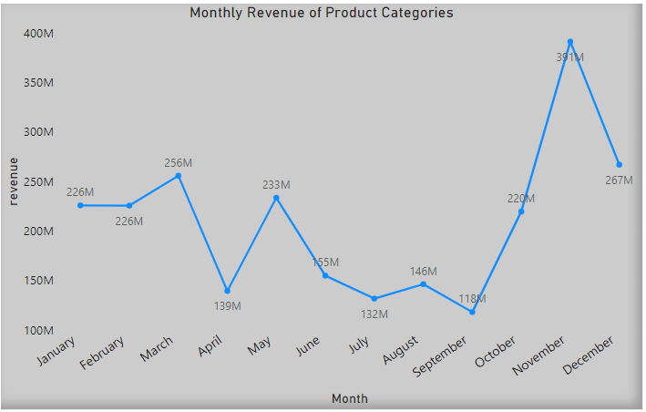
How does monthly revenue vary across different product categories ?
As we can see monthly revenue of product categories is start decreasing in May and in September it hit lowest of the year 118M but in next two month it increase significantly and in November it hit highest of the year 391M.

Slide 13
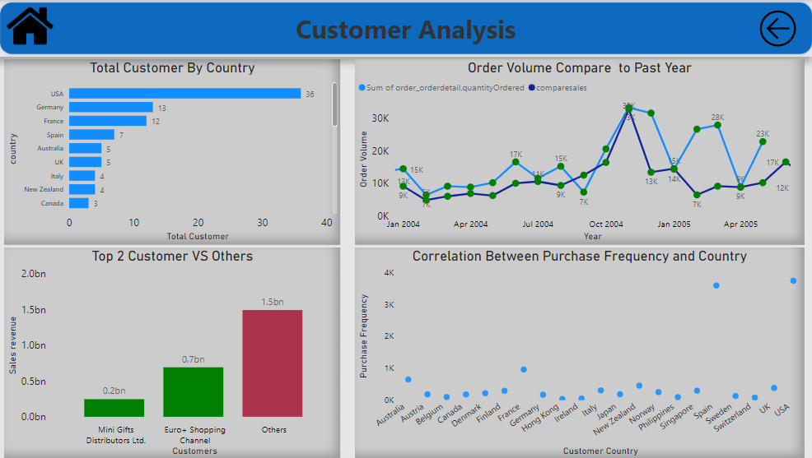

Slide 14
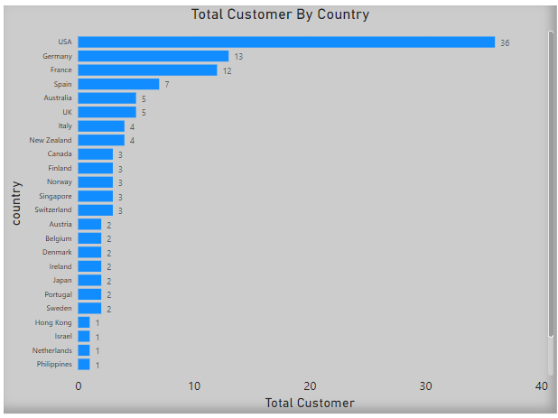
What is the distribution of customers across different countries ?
As we can see USA has highest number of customer 36 and after Germany , France , Spain , Australia ,and UK . We can least number of customer are in Hong Kong , Israel , Netherlands and Philippines.

Slide 15
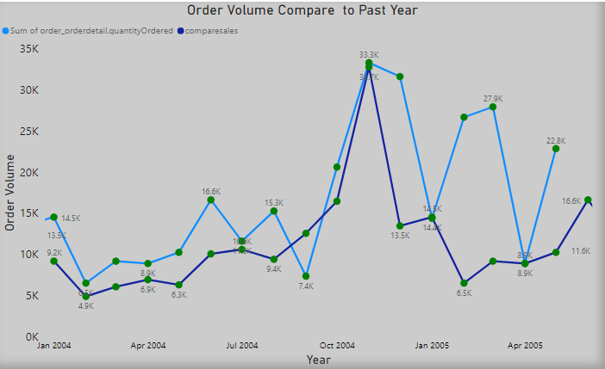
What is the trend in customer order volume over the past year ?
In this visual we can see order volume in year 2004 compare to 2003 is less but in July to October it cross last year order volume and in November it almost equal to last year highest. Order volume in Jan 2005 and April 2005 is equal to year 2004 but less in February and March.

Slide 16
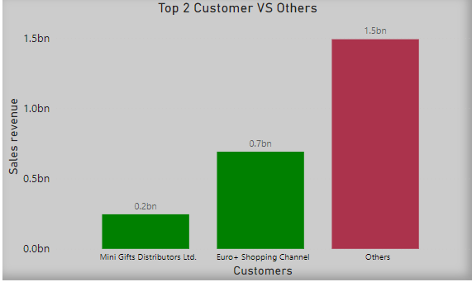
How does the sales performance of top customers compare to the rest ?
We can see top two customer Mini gifts distribution ltd and Euro+ Shopping channel contributing 0.9bn that is 37.5% of our total sales revenue.

Slide 17
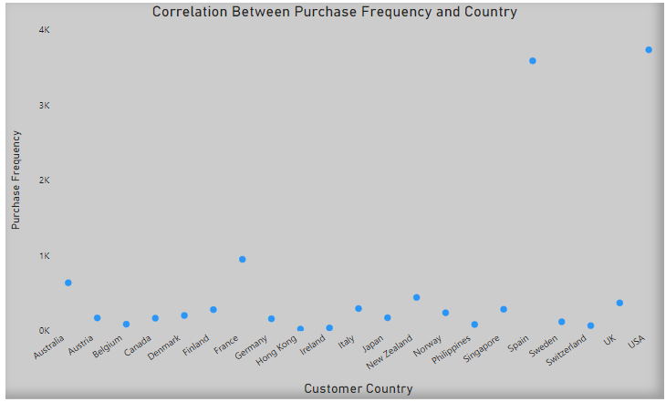
What is the correlation between customer demographics and purchase frequency ?
As we can see correlation between customer country and their purchase frequency , USA and Spain has highest purchase frequency and Hong Kong has lowest.

Slide 18
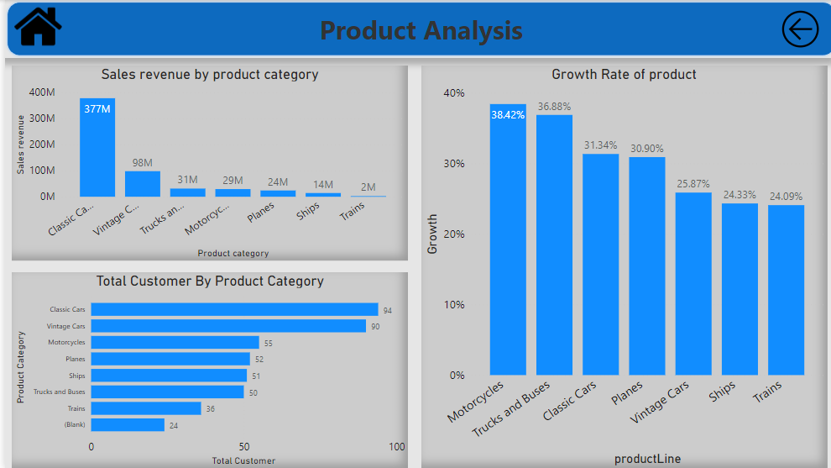

Slide 19
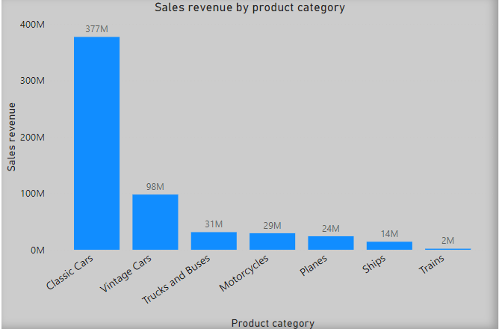
What is the distribution of product sales across different product line ?
Here we can clearly see that classic cars generate highest revenue 377M after that vintage cars (98M) . Revenue from Trains is lowest (2M).

Slide 20
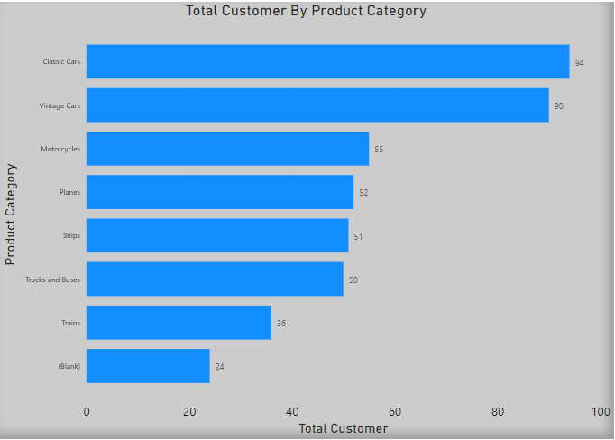
What is the distribution of customers across different Product categories ?
Classic cars and Vintage cars are on top with 94 and 90 customer . After that Motorcycles , Planes , Ships , Trucks and Buses , and last is Train with 36 customers.

Slide 21
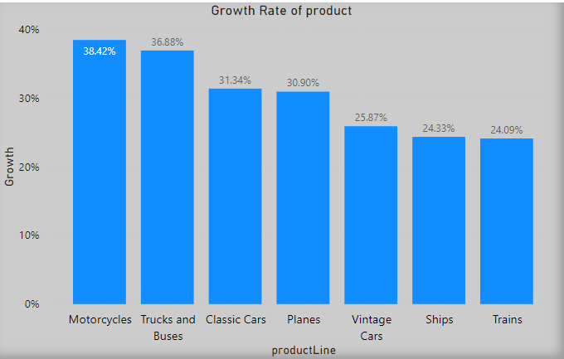
What is the growth rate of product category ?
In this visual we can see Motorcycle has the highest growth rate 38.42% . Trucks and buses has Second highest growth rate 36.88% . Trains has the lowest 24.09%.

Slide 22
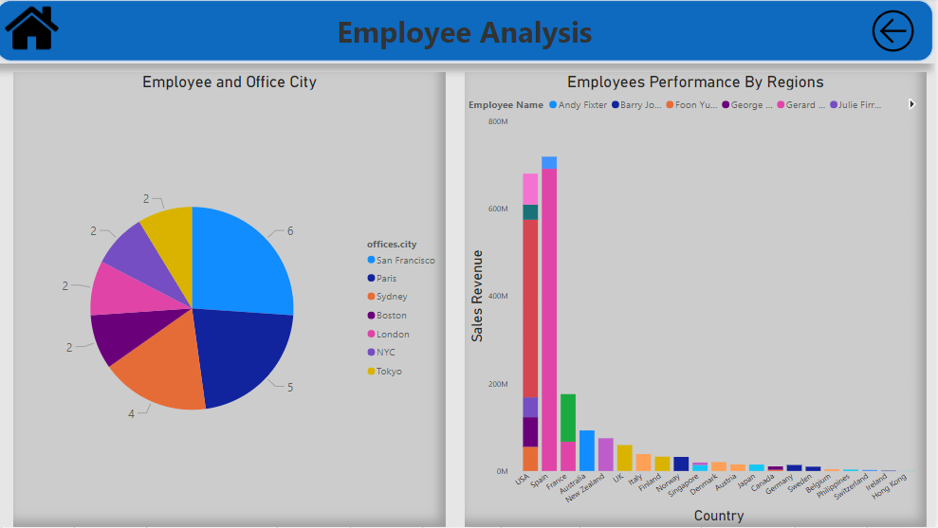

Slide 23
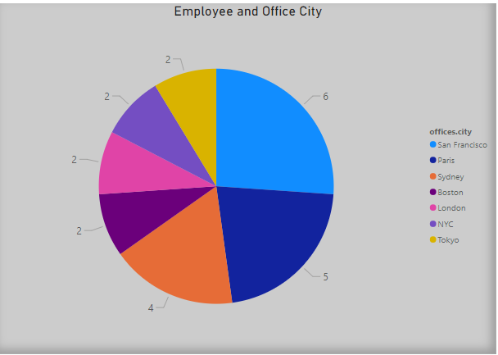
What is the distribution of employees in various office cites ?
As we can see San Francisco has the highest number of employees . Second and third is Paris and Sydney.

Slide 24
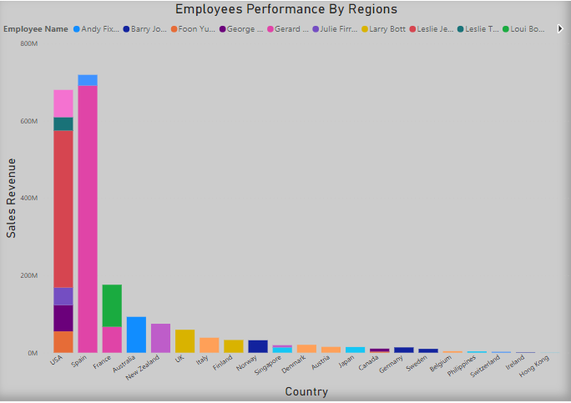
How does the performance of sales employees vary across different region ?
Performance of sales employees is vary across different region , here we can see Employee Gerard Hernandez sales revenue is above 600M in Spain but in France it is 66M.

Slide 25
EDA Problem Statements

Slide 26
EDA Questions
1 . Which Factors contribute to the highest sales in a particular region ?
2 . How can customer purchasing pattern be influenced to increase average order value ?
3 . What are the key drivers of sales growth , and how they be leveraged for future success ?
4 . Are there any specific market segments where a particular Product is underperforming and how can it be improved ?
5. What are the main factors that influence customer loyalty and repeat purchase ?
6.What are the characteristics of high value customer and how can similar customers be targeted for acquisition ?
7. How can Marketing strategies be tailored to target specific demographics segments in different region ?
8. How do customer preference and behaviour differ based on geographics factors and how can they leveraged for personalized marketing campaigns ?
9. How do customer preference differ based on geographic location , and how can marketing campaigns be customized accordingly ?
10. What are the potential untapped markets based on demographics indicators , and how can market penetration be increased ?

Slide 27
Following Questions do not have Sufficient data--
1. Which product features or attributes are most appealing to customers ?
2. How can the product mix be optimized to cater to changing market demands ?

Slide 28
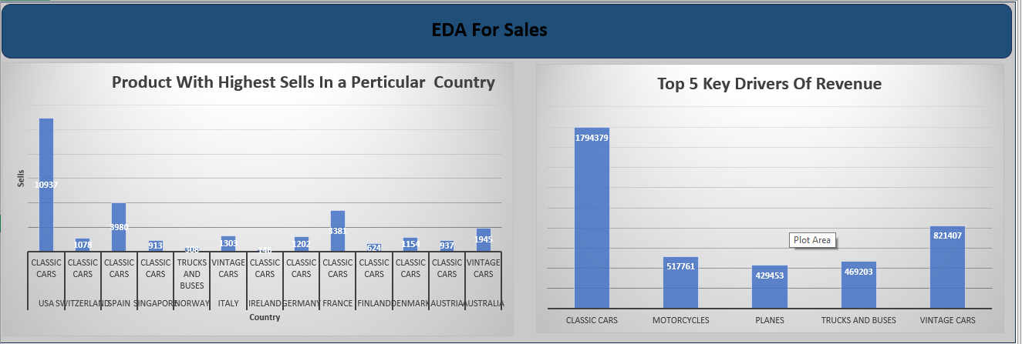

Slide 29
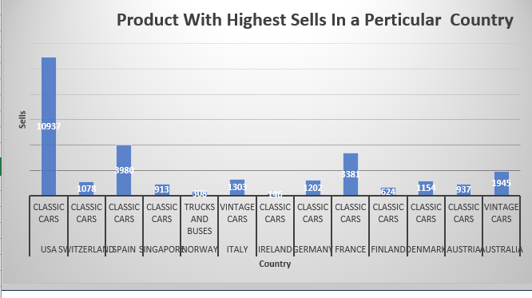
Which Factors contribute to the highest sales in a particular region ?
According to the EDA we can see most of highest sales is from classic cars and after it vintage cars but in Norway trucks and Buses contribute highest sales.

Slide 30
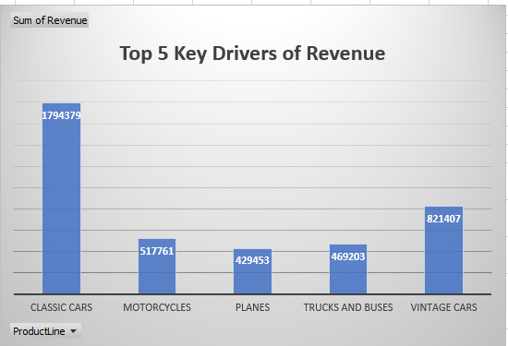
What are the key drivers of sales growth , and how they be leveraged for future success ?
Top 5 key driver of sales growth are classic cars , vintage cars , motorcycles , Trucks and buses , and Planes. For future success we can invest more in these product categories , introduce new features and take marketing decisions .

Slide 31
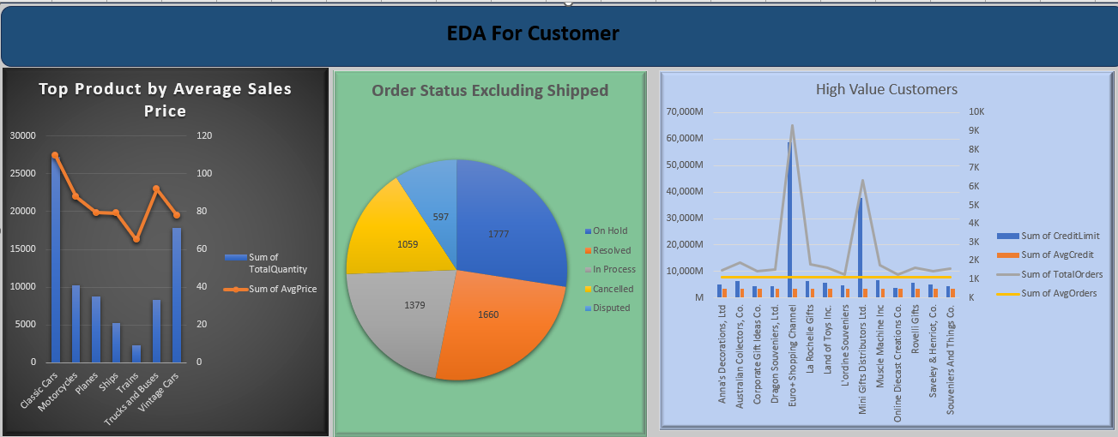

Slide 32
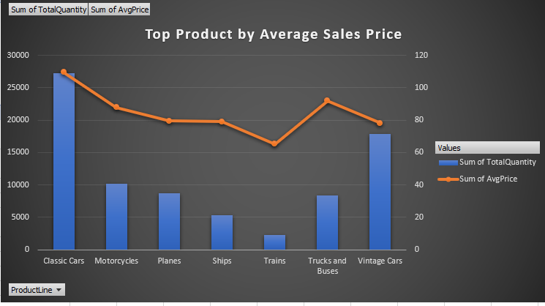
How can customer purchasing pattern be influenced to increase average order value ?
Here we can see total order quantity of classic cars is high and the average price for it also high . Trend in total order and average price is proportional but Trucks and Buses does not follow the trend.

Slide 33
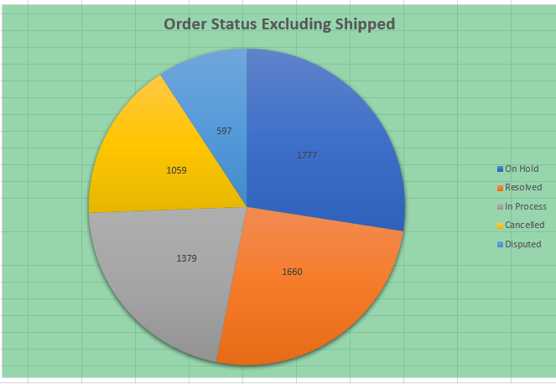
What are the main factors that influence customer loyalty and repeat purchase ?
Customer loyalty and repeat purchase is depend on product quality and customer satisfaction. Here we can see 597 products are disputed , 1059 products are cancelled , 1777 are on hold , 1660 resolved and 1379 are in process , these things can influenced customer loyalty and repeat purchase.

Slide 34
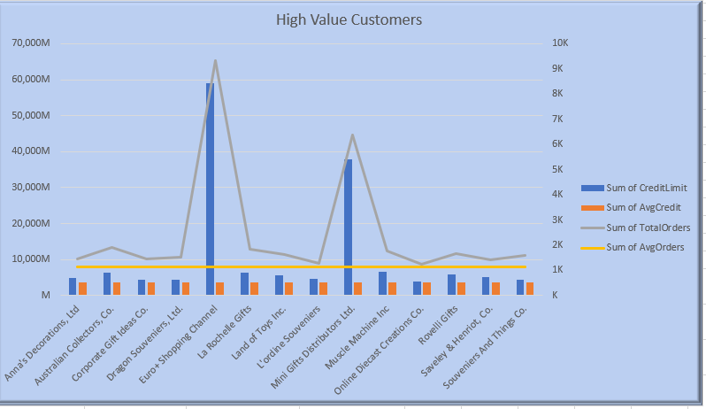
What are the characteristics of high value customer and how can similar customers be targeted for acquisition ?
Characteristics of high value customers are they have Credit limit more than average credit limit and total orders are more than average orders , So according to this criteria we have 14 high value customers . We can target these customer by giving some discount and special offers.

Slide 35
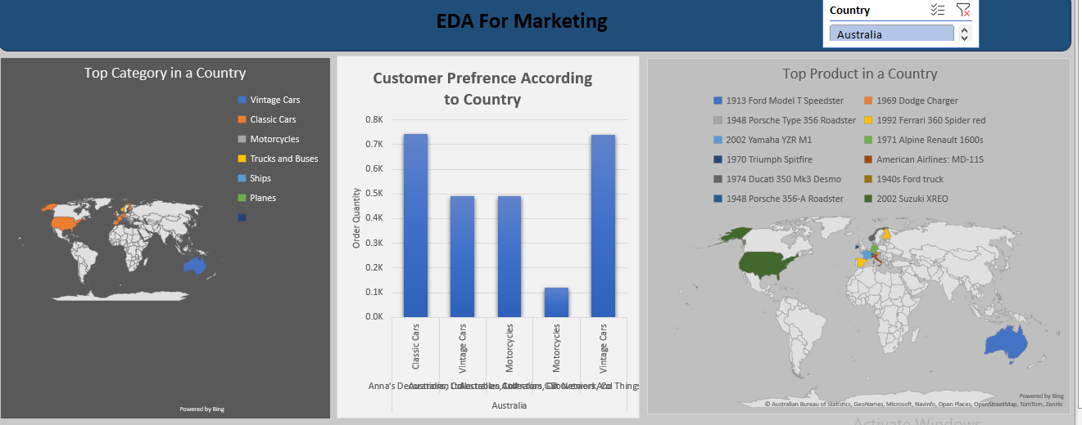

Slide 36
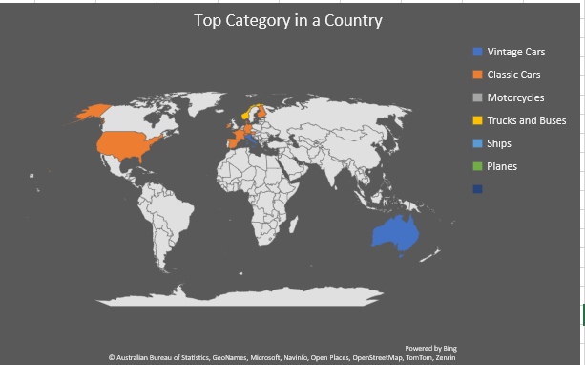
How can Marketing strategies be tailored to target specific demographics segments in different region ?
We can make our marketing strategies on the basics of top performing category in a specific region . Like in USA classic cars is top performer and in Australia vintage cars is top performer

Slide 37
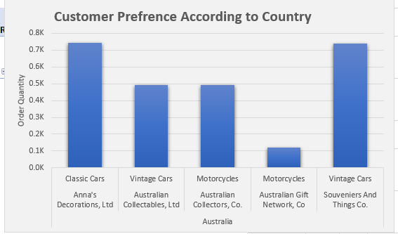
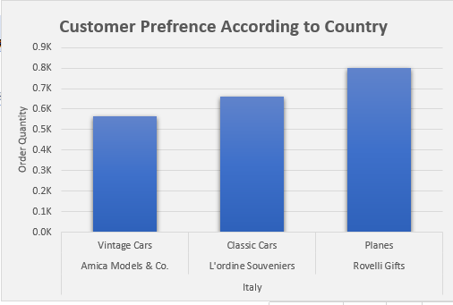
How do customer preference and behaviour differ based on geographics factors and how can they leveraged for personalized marketing campaigns ?
Customer preference is differ based on geographic location as we can see in Australia classic cars and vintage cars are preferred by customers but in italy we can see planes are ordered more as compared to classic cars and vintage cars.so we can customise our marketing strategies according to customer preference .

Slide 38
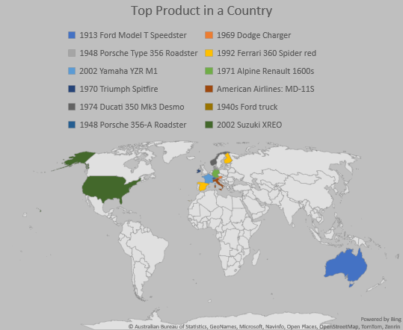
How do customer preference differ based on geographic location , and how can marketing campaigns be customized accordingly ?
Customer preference is differ based on geographic location as we can see in Australia 1913 Ford Model T Speedster preferred by customers but in italy we can see American airlines : MD-115 is ordered more .so we can customise our marketing strategies according to customer preference .

Slide 39
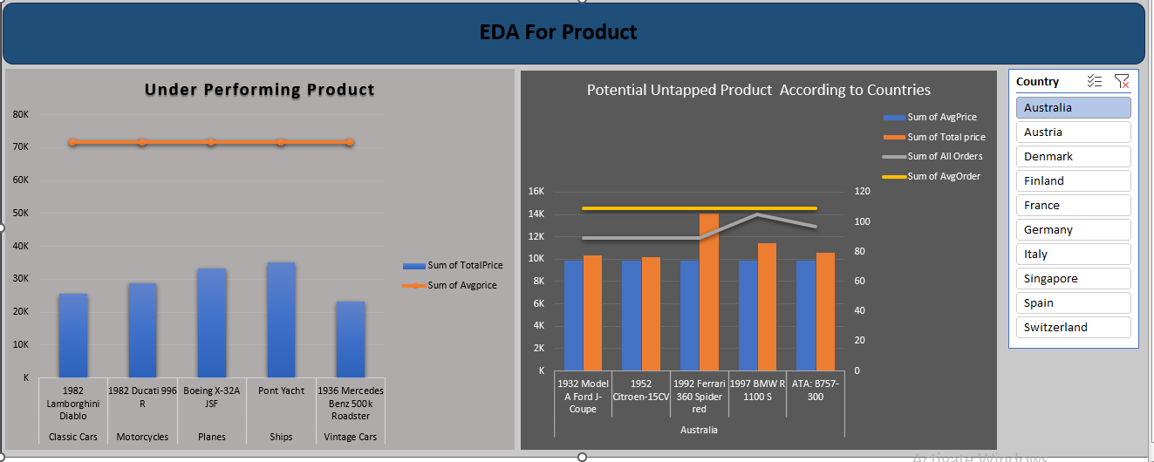

Slide 40
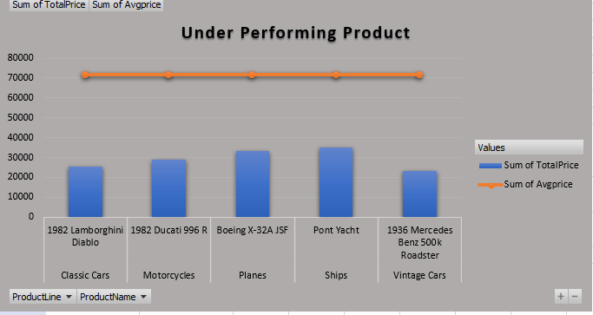
Are there any specific market segments where a particular Product is underperforming and how can it be improved ?
Yes , As we can see here 5 products in different market segment are under Performing . We can improve them by introducing some new and popular features , giving discount and marketing that can catch pulse of people .

Slide 41
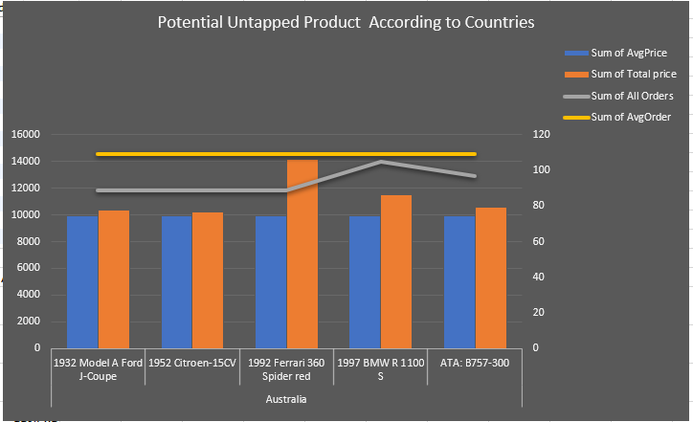
What are the potential untapped markets based on demographics indicators , and how can market penetration be increased ?
Many regions has potential untapped markets . In this visual we can see Australia has 5 products that has enough potential . We can use these products to increase market penetration . We can make some new marketing and pricing strategies for these products .

Slide 42
Thank You

